Slide 1
Route Tables & NAT Gateways
Directing Traffic

Slide 2
Route Tables
Route traffic within your VPC, subnet, CIDR range, IGW
When you create a VPC you get a ‘Main’ route table by default
By default ’Main’ doesn’t allow traffic to/from the internet
You can create an additional route table for your public routes/subnet
Every subnet gets associated route table (defaults to main, so don’t put your public routes in main)

Slide 3
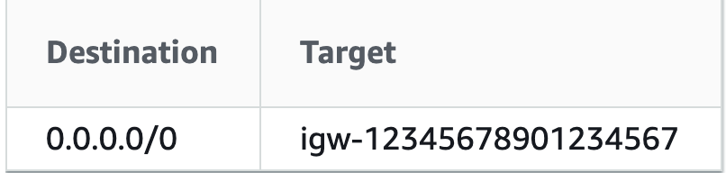
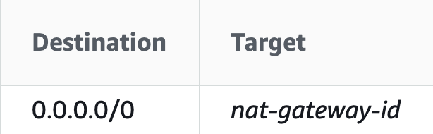
Example
Destination
Defines WHAT traffic
Target
Defines WHERE traffic can travel via
0.0.0.0/0 represents all routes not already defined

Slide 4
Give’s the public subnet internet access
Give’s the private subnet access to their on-prem infra

Slide 5
NATGW
Network Address Translation – translates private IP’s to IP’s that the internet can understand
Egress traffic (from your private subnet to the internet, but not your internet to your private subnet)
Sits in the Public subnet with an EIP (Elastic IP) or a public IP

Slide 6
Give’s the private subnet access to the internet via the NATGW

Slide 7
Testing your NATGW
Create an SSM-authorized role and attach it to an EC2 in the public subnet
Use an SSM agent as a bastion host to connect to a private webserver
Ping 8.8.8.8 (Google) – Let’s see what happens!
Notes:
SSM removes the need to handle AWS credentials – best used for general direct server maintenance

Slide 8
